Slide 1
Category review: Chips
August 29
Retail Analytics

Slide 2
Notes:
To view Privacy video explaining how important data privacy is to Quantium, please click here: https://www.youtube.com/watch?v=Zq1QDAkoRzU
or here Q:\Company Reference\Brand & Design\Brand videos\Q Privacy.mp4
At Quantium, we believe that data is the behavioural footprint of humanity and that it has to be treated with the utmost care and responsibility.
Histories, attitudes, indeed lives are stored within it in ways that aren’t always apparent – and that’s what makes its potential so powerful.
To work with it responsibly, sensitively, we set ourselves the highest data privacy protection and governance standards.
We have spent 17 years perfecting privacy-by-design and secure-by-design principles. Central to this is not holding any personally identifiable information about people –
we neither receive it, and put the necessary protections in place to be unable to decipher it.
Every aspect of handling data is safeguarded: from its de-identification, to its encryption – data security is paramount and of the highest grade.
We pride ourselves on gaining the trust of iconic organisations around the world through years of securely working with their data,
and in turn the trust that builds with their stakeholders.

Slide 3
Executive summary
01
Chips Category Review
The Mainstream category of Young and Mid-age Singles/Couples have the highest spending of chips per purchase.
The Older Families(Budget) have the highest frequency of purchase followed by Young Singles/Couples (Mainstream) and at last Retirees (Mainstream) contributing to a total 25% sales revenue.
Chips Brand Kettle is the most purchased brand in all stores.
Young and Mid-age Singles/Couples is the only segment having Doritos as the highest purchase brand while Smiths is for other segments.
Most frequent chip size purchased is 175 gr followed by 150 gr size for all segments.
Chips transactions increase a lot before Christmas which can be an advantage with the help of promotional offers.
02
Store Analysis
Trial stores 86 and 88 have significant increase in total sales and number of customers during trial as compared to control store.
Trial store 77 had increase as well but not as good as stores 86 and 88.

Slide 4
01
Category

Slide 5
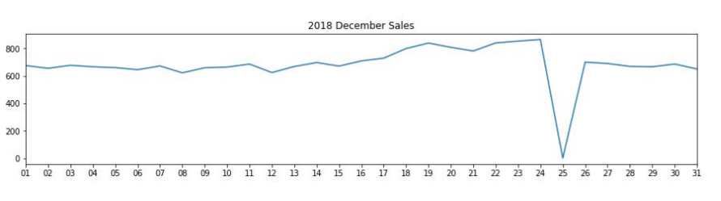
The day with no transaction is a Christmas day that is when the store is closed hence there is a dip in sales on 25th December as shops were non-operational.
Sales increase steadily as the Christmas day approaches and return again to early December sales level during New Year Eve.

Slide 6
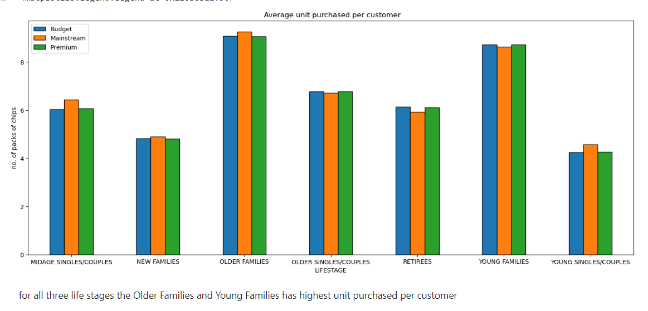
Sales mainly came from Budget - older families, Mainstream - young singles/couples, and Mainstream - retirees. In total contributing 25% of sales revenue.
Older and Young Family segment have the highest average purchase units per unique customer

Slide 7
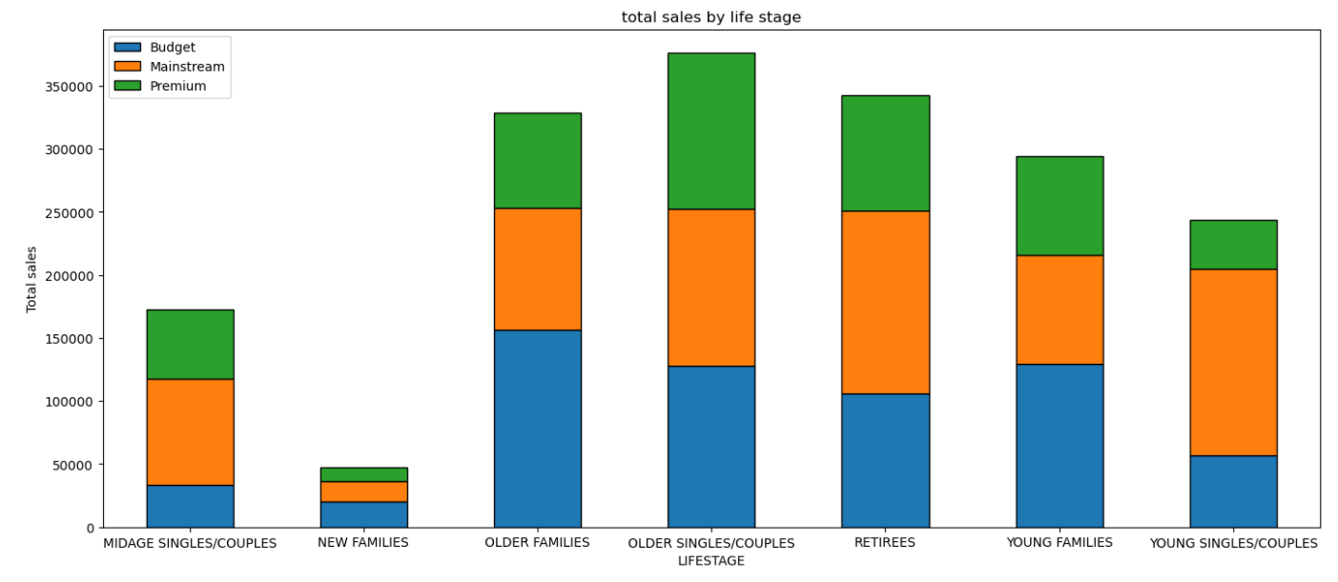
Sales mainly came from Budget - older families, Mainstream - young singles/couples, and Mainstream - retirees. In total, older customers buy more than younger customers. Non-premium customers buy more than premium customers.

Slide 8
02
Trial store performance

Slide 9
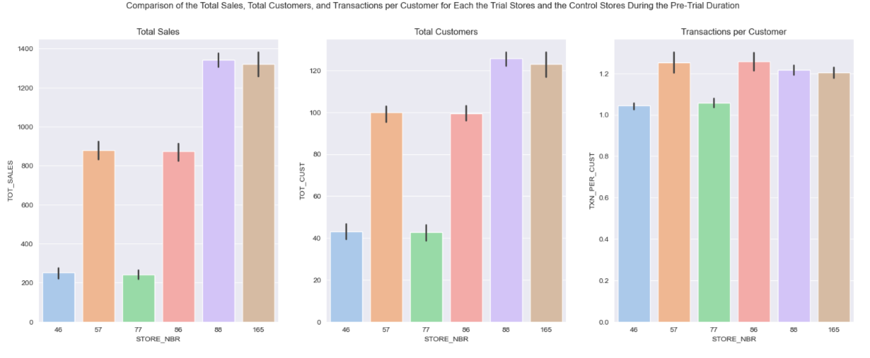
Trial store 77: Control store 46
Trial store 86: Control store 57
Trial store 88: Control store 165

Slide 10
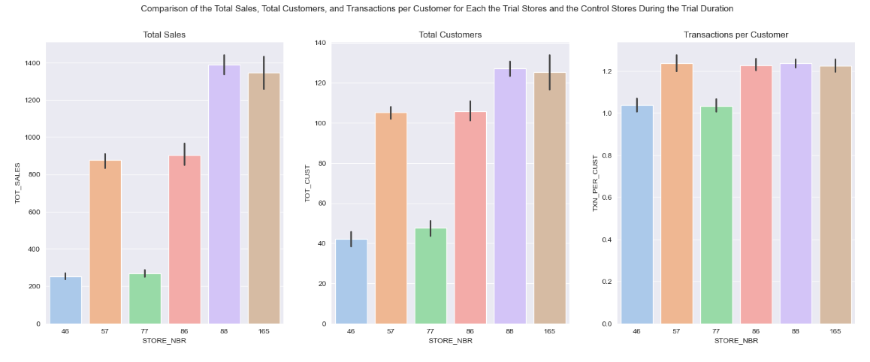
We can, once again, notice that STORE_NBR 88 slightly out-performs its control store, STORE_NBR 165, and still remains the best implementation of the trial of all the trial stores. The driver for this seems to be the purchasing customers rather than purchases per customer, as we can see that with the increase in the total customers, there's also an increase in the total sales almost identically, but the transactions per customer seem to be reasonably high for all the trial stores regardless of the total sales.

Slide 11
Conclusion:
we can see that for trial store 77,86 and 88 the control store 46, 57 and 165 are chosen respectively as the Total Sales, Total Customers, and Transactions per Customer are similar for these.
While the other trial stores performed the same as their corresponding control stores, we can see, however, that STORE_NBR 88 slightly out-performed its control store, STORE_NBR 165, in all attributes.
STORE_NBR 86 and 88 show a significant difference in terms of the total sales, but this isn't the case with STORE_NBR 77, which may be because of the way the trial was implemented for it.
Due to the maximum difference in the total sales of all the trial stores, STORE_NBR 88 remains the best implementation of the trial.
The driver for the increase in total sales seems to be the purchasing customers rather than purchases per customer — the more the customers, the higher the sales.

